Slide 1

Cookies vs Sessions
CSA4305 INTERNET PROGRAMMING
Presented By: T Gnaneswari
192372183

Slide 2
Cookies vs Sessions
Cookies and sessions are widely used to maintain user state in otherwise stateless HTTP communication.
Cookies mainly store data on the client/browser.
Sessions mainly store user data on the server and identify the user through a session ID.

Slide 3
What Are Cookies?
A cookie is a small piece of data stored in the user's web browser.
The browser automatically sends relevant cookies with later HTTP requests.
Common uses: preferences, language selection, shopping-cart identifiers, analytics, and authentication tokens.
Cookies can be temporary (session cookies) or persistent with an expiry time.
What Are Sessions?
A session stores user-specific state on the server.
The browser usually holds only a session identifier, commonly in a cookie.
The server uses that identifier to retrieve login status, cart information, permissions, or other session data.
Sessions normally expire after logout or a configured inactivity period.

Slide 4
Cookies vs Sessions – Comparison
Factor | Cookies | Sessions
Storage | Client/browser | Server
Typical data | Small values / identifiers | User state and server-side data
Security | More exposed to client-side risks | Sensitive data stays server-side
Capacity | Limited | Depends on server/session store
Server load | Low storage burden | Consumes server/session-store resources
Expiry | Configured by cookie attributes | Controlled by server timeout/logout

Slide 5
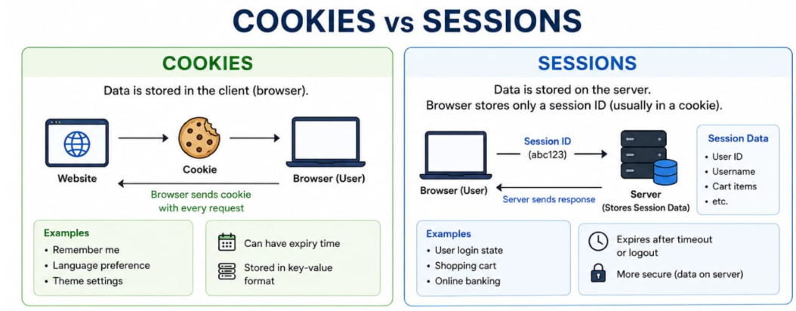

Slide 6
Security Risks
Cookie risks: theft through XSS when not HttpOnly, interception without HTTPS/Secure, tampering when values are unsigned, and CSRF when cookies are automatically sent.
Session risks: session hijacking, session fixation, weak session IDs, excessive session lifetime, and insecure server-side storage.
Important protections: HTTPS, Secure, HttpOnly, SameSite, unpredictable session IDs, session rotation after login, short timeouts, and logout invalidation.

Slide 7
Performance Considerations
Cookies add data to matching HTTP requests, so large cookies increase network overhead.
Sessions reduce client-side data but require server storage and session lookup.
Large-scale applications may use Redis or distributed caches for fast session access across multiple servers.
Best practice: keep cookies small and keep only necessary information in the session.

Slide 8
Real-Time Use Cases
Login system: session stores authenticated user state; browser keeps a secure session ID cookie.
E-commerce cart: a guest cart identifier may be kept in a cookie; authenticated cart data can be stored server-side.
Banking/financial apps: server-side sessions with short inactivity timeouts are preferred for sensitive workflows.
Website preferences: theme, language, or consent choices can be stored in cookies when appropriate.
Admin dashboard: sessions can maintain authenticated role and permission context.

Slide 9
Example Login Flow
1. User submits username and password.
2. Server verifies credentials and creates a session.
3. Server sends a session ID in a Secure, HttpOnly cookie.
4. Browser sends the cookie with later requests.
5. Server finds the session and recognizes the authenticated user.
6. On logout, the server invalidates the session and expires the cookie.

Slide 10
Critical Analysis & Conclusion
Cookies are simple and scalable for small client-side state, but sensitive information should not be stored directly in them.
Sessions provide stronger control over sensitive server-side state but require storage, cleanup, and scaling strategies.
Cookies and sessions are not always alternatives: many session systems use a cookie to carry the session ID.
For authentication, combine server-side session controls with secure cookie attributes and HTTPS.

Slide 11
Thank you

